Slide 1
A staff training resource from
the Internet Watch Foundation.

Slide 2
What do teenagers mean when they share:
🍆

Slide 3
What do teenagers mean when they share:
🍒

Slide 4
What do teenagers mean when they share:
🍑

Slide 5
What do teenagers mean when they share:
🌮

Slide 6
What do teenagers mean when they share:
💦

Slide 8
1/3
⅓ of young people have sent a sexual image of themselves.
1/2
½ of young people have received a sexual image from someone else.
9%
9% of young people have been sent a sexual image of someone else.
Source: ‘Digital Romance: A research project exploring young people’s use of technology in their romantic relationships and love lives’ from Brook.

Slide 9
92%
‘Self-generated’ content was found on 92% of all the webpages the IWF took action to remove in 2023.
Sharing nudes can have devastating consequences.

Slide 10
Young people can share messages on most social media and messaging platforms – including images and videos.
https://www.brook.org.uk/wp-content/uploads/2020/03/DR_REPORT_FINAL.pdf
Notes:
Tik Tok, Reddit, Whatsapp, Facebook, Facebook Messenger, Snapchat, BeReal, X, Instagram, Threads, Discord

Slide 11
Most smartphones let users share images and video through Bluetooth directly to other phones. Some young people use this to share unsolicited sexual images.
Airdrop
Nearby share
Notes:
Airdrop, Nearby Share

Slide 12
Young people can also share images, videos and livestreams through gaming platforms – where it’s easy for them to be approached by strangers.
Twitch
Xbox Live
Playstation network
Steam
Nintendo network

Slide 13
Anyone creating, distributing or in possession of an indecent image of someone under 18, is committing an offence under the Protection of Children Act 1978.
For more detail, visit the Government website
Notes:
Link: https://www.gov.uk/government/publications/sharing-nudes-and-semi-nudes-advice-for-education-settings-working-with-children-and-young-people/sharing-nudes-and-semi-nudes-advice-for-education-settings-working-with-children-and-young-people

Slide 14
Sharing nudes covers a range of behaviour, from consensual exchanges of images within a relationship to sharing that is coerced or exploitative.
It’s helpful to divide nude sharing into two categories: experimental and aggravated.

Slide 15
Young people are sharing nudes for many reasons. Some of these are part of exploring their sexuality in a digital world, such as:
Wanting to flirt with someone they’re interested in
Finding sexual enjoyment and intimacy as part of a relationship
Boosting body confidence
Searching for validation due to low self esteem

Slide 16
However, some young people are sharing nudes in response to pressure – or in response to grooming and exploitation.
This could look like:
Pressure from a partner, or a friend
Blackmail or threats, including extortion for money – aka ‘sextortion’
An adult predator grooming them
Deception, where someone poses as a young person to solicit images
Girls reported feeling more pressure to share images than boys – as did non-binary young people. The vast majority of sextortion cases at present involve boys.
https://www.brook.org.uk/wp-content/uploads/2020/03/DR_REPORT_FINAL.pdf
Notes:
Find more information at: https://www.brook.org.uk/wp-content/uploads/2020/03/DR_REPORT_FINAL.pdf
https://www.gov.uk/government/publications/sharing-nudes-and-semi-nudes-advice-for-education-settings-working-with-children-and-young-people/sharing-nudes-and-semi-nudes-advice-for-education-settings-working-with-children-and-young-people

Slide 17
Young people are at risk of their images being shared with wider networks – such as their year group at school.
Broadly speaking, girls are more vulnerable:
Due to sexist attitudes, images of girls can have greater currency within groups of young people.
The association with sexual images can expose girls to shaming behaviours and bullying.
Even if an image isn’t actually of a young person, the rumour that it is can mean individuals are gossiped about or bullied.

Slide 18
In many cases, young people are sharing images without realising that they are distributing illegal material: indecent images of children.
In 2016, the Home Office launched Outcome 21, a code to help police deal with image sharing incidents proportionately.
Where there is no evidence of aggravating factors (e.g. grooming, exploitation or malicious intent) and there are no indicators of risk, police can record a crime as being committed without criminalising young people unnecessarily.
Notes:
https://assets.publishing.service.gov.uk/media/5a757082e5274a1622e21cb8/GD8_-_Sexting_Guidance.pdf

Slide 19
Notes:
“I was really drunk, and this boy that I really liked, like, took advantage of me and got me to do stuff, and I told him, “No,” like, quite a few times and it still happened. And then my friends, we was upstairs, and then they video recorded us, and it got sent round the whole school. I could have been pregnant and he found out and he was telling me to kill myself…
And I’d literally walk into a lesson, I’d be getting called a slag, a whore, and I didn’t wanna talk about it anyway, because I didn’t personally wanna go into it with them. So I was getting called a slag, and everything. And even my teachers were letting them call me a slag, wasn’t they? I walked out of his lesson crying, and it was so bad, like, for ages…
I’ve never liked my body, but the way I look in those photos, and stuff, it literally just made me ill. I stopped eating everything... I’ve asked the school for counselling four times, and they still haven’t given it to me. So I didn’t really get support from anyone, I had to cope with it by myself, really.” (Latoya, 16)
Source: ‘Digital Romance: A research project exploring young people’s use of technology in their romantic relationships and love lives’, from Brook

Slide 20
“I was really drunk, and this boy that I really liked, like, took advantage of me and got me to do stuff, and I told him, “No,” like, quite a few times and it still happened. And then my friends, we was upstairs, and then they video recorded us, and it got sent round the whole school. I could have been pregnant and he found out and he was telling me to kill myself…
And I’d literally walk into a lesson, I’d be getting called a slag, a whore, and I didn’t wanna talk about it anyway, because I didn’t personally wanna go into it with them. So I was getting called a slag, and everything. And even my teachers were letting them call me a slag, wasn’t they? I walked out of his lesson crying, and it was so bad, like, for ages…
I’ve never liked my body, but the way I look in those photos, and stuff, it literally just made me ill. I stopped eating everything... I’ve asked the school for counselling four times, and they still haven’t given it to me. So I didn’t really get support from anyone, I had to cope with it by myself, really.” (Latoya, 16)
Source: ‘Digital Romance: A research project exploring young people’s use of technology in their romantic relationships and love lives’ from Brook.

Slide 21
Notes:
https://assets.publishing.service.gov.uk/media/5a757082e5274a1622e21cb8/GD8_-_Sexting_Guidance.pdf
https://www.brook.org.uk/wp-content/uploads/2020/03/DR_REPORT_FINAL.pdf

Slide 22
If an incident comes to your attention, you should report to your DSL immediately. Don’t ask to see the image.
But there are five ways you can support the young people involved:
Don’t minimise the impact:
if their image has been shared without their consent, don’t minimise the impact – it can be incredibly distressing.
Avoid using victim blaming language – like saying it’s the child’s fault their image was shared, or that they shouldn’t have shared it in the first place.
Signpost them to Report Remove.
Refer them to Childline.
Ask them what the school can do to help them.
Don’t promise that every image can be taken down, but assure the student that best efforts will be made.

Slide 23
Following an incident of harmful sexual behaviour, there are a number of actions that the school should take to decide whether a safety plan is needed. All schools will have different approaches.
Consider the nature and severity of the sexual behaviour as soon as possible after the incident.
Immediately talk to the children involved, and their parents.
Be ready to manage any communications about the incident, inside and potentially outside the school community.
Consider:
the ongoing risks for all the children involved.
how contact between the children can be managed.
possible actions and arrangements to suit each child.
Find more detail on the CSA Centre website

Slide 24
Following an incident of harmful sexual behaviour, there are a number of
actions that the school should take to decide whether a safety plan is needed. All schools will have different approaches.
Hold a safety planning meeting for each child who has been harmed and their parent(s), to draft and agree content for the safety plan. Do the same for each child who has harmed and their parents.
Draw up the safety plan, share the relevant sections with all the children involved and their parents, and check their understanding.
Start implementing the safety plan, and review regularly until safety measures can be removed.
Find more detail on the CSA Centre website

Slide 25
Report Remove is a free, easy service provided by Childline and the Internet Watch Foundation.
You can help a young person aged under 18 to use the Report Remove tool to see if the image or video can be taken down, and Childline can provide further support.
Search: Report Remove
Notes:
https://www.youtube.com/watch?time_continue=56&v=SwSpo3N6CeE&embeds_referring_euri=https%3A%2F%2Fwww.childline.org.uk%2F

Slide 26
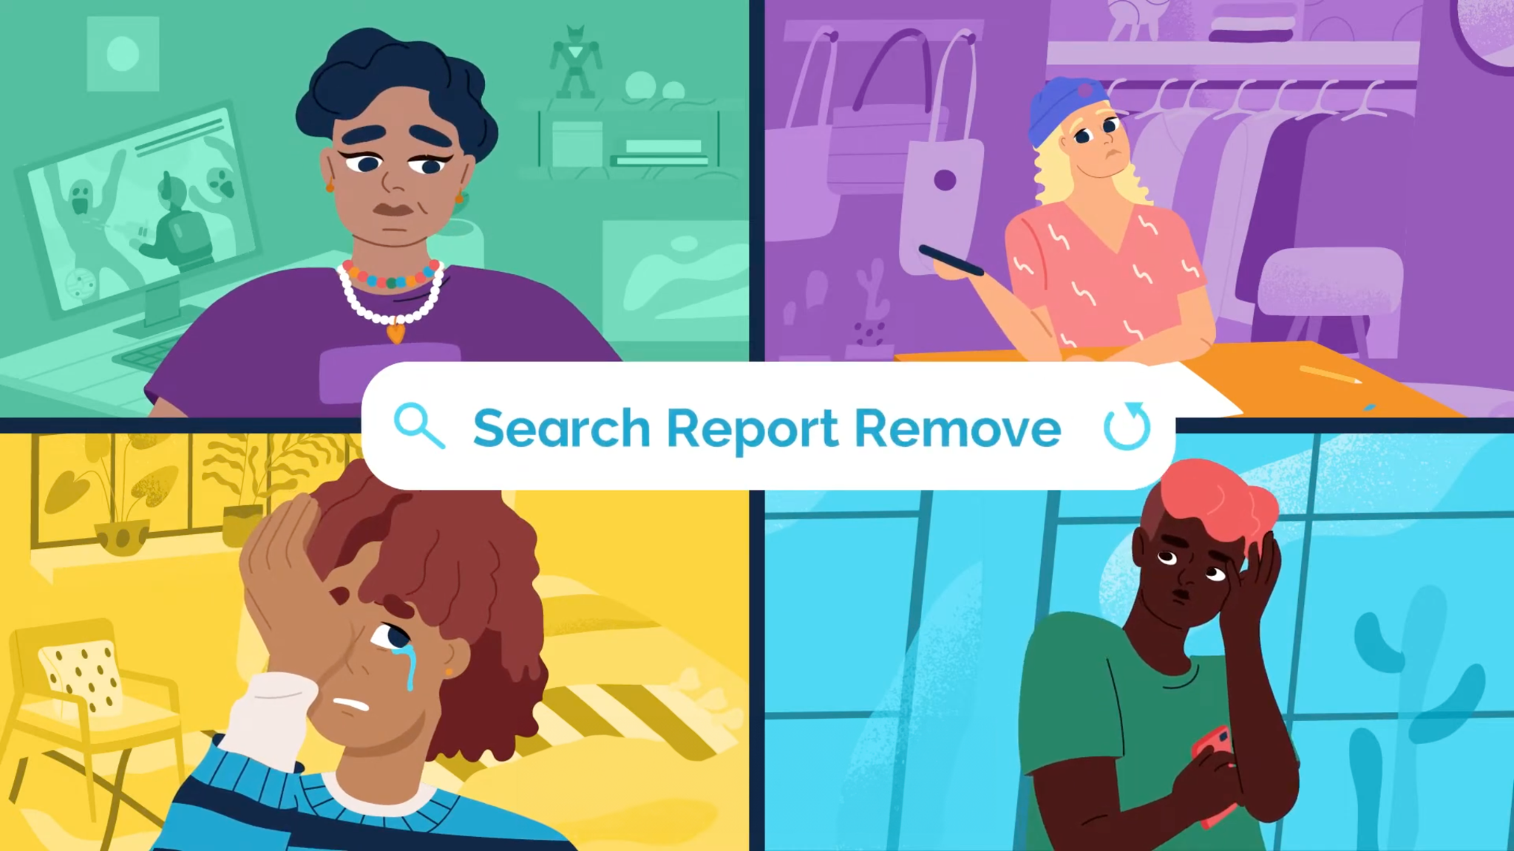
Notes:
Link: https://www.youtube.com/watch?time_continue=56&v=SwSpo3N6CeE&embeds_referring_euri=https%3A%2F%2Fwww.childline.org.uk%2F
Choice of slide between 26 or 27

Slide 27
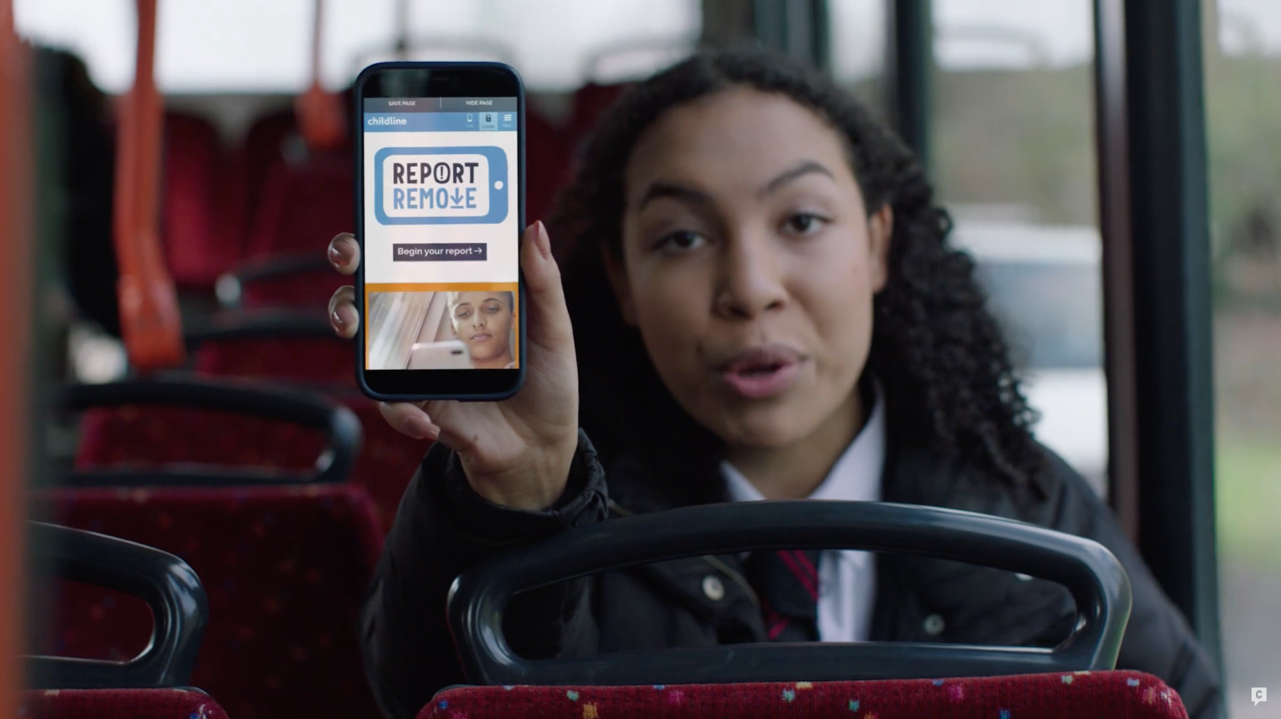
Notes:
https://www.iwf.org.uk/our-technology/report-remove/
Choice of slide between 26 or 27

Slide 28
It’s not the young person’s fault if an image has been shared without their consent.
As educators, it is vital that we avoid victim blaming – implying that young people are responsible for their image being shared without their consent.
Victim blaming can make young people feel shame at an incredibly vulnerable moment – and can reduce the likelihood of reporting other incidents or abuse in the future.

Slide 29
When an incident is brought to your attention, remember:
The fact that the young person may have created or shared an image in the first place does not mean they’re responsible for it being shared more widely.
Don’t remind the young person that they should have known better, or that you’ve covered the law in previous lessons.
Don’t immediately tell a young person what they should have done, or that they have responsibility to ‘keep themselves safe’.

Slide 30
Remember, a student making a disclosure needs to feel safe, and heard.
Make your body language and tone welcoming, and conduct the conversation in an appropriate place.
Try calm, reassuring phrases like:
"Would you like to tell me what’s going on?”
“I’m here to listen to you – remember that you’re not alone, and the school will try to help you in any way we can.”
“It’s brave to share this – thank you.”

Slide 31
The following scenarios are real-life situations that you could be presented with. How would you approach each one?

Slide 32
Notes:
Rez is in year 10. For the past couple of days, he’s been messaging a girl he likes in the year below. They seem to be getting on well, and he wants to take their relationship to the next level.
Some of his mates have been sharing nude pics of themselves with girls they’re going out with, so he decides to do the same. He takes a few ‘dick pics’ and sends them to the girl he’s chatting to. But he doesn’t ask her first.
The girl just replies saying ‘WTF’ and blocks him. Rez realises he’s done something wrong. But the next day, things get worse.
His mates all start messaging him – saying they’ve seen his ‘dick pic’ in one of the group chats he’s not in. Suddenly his pics are going round the whole school, and everyone seems to be talking about it.

Slide 33
Rez is in year 10. For the past couple of days, he’s been messaging a girl he likes in the year below. They seem to be getting on well, and he wants to take their relationship to the next level.
Some of his mates have been sharing nude pics of themselves with girls they’re going out with, so he decides to do the same. He takes a few ‘dick pics’ and sends them to the girl he’s chatting to. But he doesn’t ask her first.
The girl just replies saying ‘WTF’ and blocks him. Rez realises he’s done something wrong. But the next day, things get worse.
His mates all start messaging him – saying they’ve seen his ‘dick pic’ in one of the group chats he’s not in. Suddenly his pics are going round the whole school, and everyone seems to be talking about it.

Slide 34
Here’s how to respond to common reactions to Rez’s story.
“Rez is in the wrong because he sent his photos without permission.”
Explain that, yes, he made a mistake. He didn’t have consent to share his nudes, and that is wrong. But sharing the image on is wrong, too.
“What happened next?”
Frame this as a class discussion – what do they think the consequences will be?
“Everyone sends nudes, what’s the problem?”
Remind students of the law, and the Government guidelines – and potentially open a discussion about whether it’s right to share nude photos at any age.
Session preparation
Notes:
For teachers use only

Slide 35
Imagine Rez comes to you to report that this has happened.
What do you do next?

Slide 36
If Rez confided in you, you should:
Make sure he feels safe – choose a room or space he feels comfortable in. Ask if he’d like someone else present
Without blaming him, ask him to explain the situation. But explicitly ask him not to show you any images or videos
Ask who he thinks forwarded the images and ask for details
Ask who else may have seen the images
Recommend that Rez uses Report Remove
Going further, you should:
Talk to his parents, and the DSL
Speak to the girl’s parents, or school
Speak to others that may have seen (or have) the image
If Rez’s parents feel it necessary, discuss with the police
At a later date, discuss the issues around image sending with Rez
Above all, reassure Rez that you’ll do your best to help him take the images or video down. But that you’ll need to let others know to make this happen.

Slide 37
Notes:
When Roxy was in year 8, she got a message from a boy in the sixth form. She felt flattered to get attention from him, so when he asked for her socials, she said yes.
He used to message her every day, asking for pictures from her. Eventually, he asked her for nude photos – and she thought he’d lose interest if she didn’t send them.
No matter what she sent, he kept asking for more explicit pictures – so eventually she stopped talking to him. But a few weeks later, she found out that he’d sent her photos to other boys in her school.
Her photos were being shared on social media without her consent, and going round the whole year. People were calling her really hurtful names.
When the school found out, they made her write an essay as a punishment – while nothing happened to the boys who shared her photos.
Roxy is a real person. Now, she’s in her twenties – and educates young people about the dangers of sharing nudes, and how it’s not their fault if their images are shared without their consent.

Slide 38
When Roxy was in year 8, she got a message from a boy in the sixth form. She felt flattered to get attention from him, so when he asked for her socials, she said yes.
He used to message her every day, asking for pictures from her. Eventually, he asked her for nude photos – and she thought he’d lose interest if she didn’t send them.
No matter what she sent, he kept asking for more explicit pictures – so eventually she stopped talking to him. But a few weeks later, she found out that he’d sent her photos to other boys in her school.
Her photos were being shared on social media without her consent, and going round the whole year. People were calling her really hurtful names.
When the school found out, they made her write an essay as a punishment – while nothing happened to the boys who shared her photos.
Roxy is a real person. Now, she’s in her twenties – and educates young people about the dangers of sharing nudes, and how it’s not their fault if their images are shared without their consent.

Slide 39
Here’s how to respond to common reactions to Roxy’s story.
“Roxy shouldn’t have shared her photos”
Be ready to challenge ‘slut-shaming’ or victim-blaming attitudes. Remind students that Roxy was a young teenager at the time, and that the pressure put on her was wrong.
“Roxy’s school was in the wrong, so I wouldn’t tell teachers anything”
Explain that Roxy’s story is from a few years in the past, and that schools have moved on since. Reiterate that everyone at this school is here to help.
“Everyone sends nudes, what’s the problem?”
Remind students of the law, and the Government guidelines – and potentially open a discussion about whether it’s right to share nude photos at any age.
Session preparation

Slide 40
Imagine Roxy has told you this is happening.
What do you do next?

Slide 41
If Roxy confided in you, you should:
Make sure she feels safe – choose a room or space she feels comfortable in. Ask if she’d like someone else present
Without blaming her, ask her to explain the situation. But explicitly ask her not to show you any images or videos
Ask who she thinks shared the images and ask for details
Ask who else may have seen the images
Recommend that Roxy uses Report Remove
Going further, you should:
Talk to her parents, and the DSL
Speak to the boys that may have seen or have shared the image – and potentially their parents
If Roxy’s parents feel it necessary, discuss with the police
Above all, reassure Roxy that you’ll do your best to help her take the images or video down. But that you’ll need to let others know to make this happen.

Slide 42
Notes:
Jack’s in year nine. He’s been questioning his sexuality for a while and he’s curious about what it would be like to have a boyfriend.
One night, a friend’s older brother (who’s in year 11) messages him. They start chatting. The messages become more flirty until the older boy asks Jack for a nude pic. Jack sends it. The other boy doesn’t send one back, and ghosts him.
The next day, Jack’s at football practice. Some of his teammates are laughing, saying they’ve seen him naked. He feels embarrassed and doesn’t know who else has seen the pics.

Slide 43
Jack’s in year nine. He’s been questioning his sexuality for a while and he’s curious about what it would be like to have a boyfriend.
One night, a friend’s older brother (who’s in year 11) messages him. They start chatting. The messages become more flirty until the older boy asks Jack for a nude pic. Jack sends it. The other boy doesn’t send one back, and ghosts him.
The next day, Jack’s at football practice. Some of his teammates are laughing, saying they’ve seen him naked. He feels embarrassed and doesn’t know who else has seen the pics.

Slide 44
Here’s how to respond to common reactions to Jack’s story.
“How is Jack meant to explore his sexuality if he can’t send pics”
Recognise that, at Jack’s age, it’s normal to be curious. But it’s better to discuss with a trusted adult than with people on the internet. Remind them that, as the legal age for sexual acts is 16, Jack is still a minor.
Any homophobic comments.
Challenge these, and refer to the school’s anti-bullying policy.
“Everyone sends nudes, what’s the problem?”
Remind students of the law, and the Government guidelines – and potentially open a discussion about whether it’s right to share nude photos at any age.
Session preparation

Slide 45
While on break duty, you overhear two students laughing about Jack’s images being shared.
What do you do?

Slide 46
If Jack confided in you, you should:
Make sure he feels safe – choose a room or space he feels comfortable in. Ask if he’d like someone else present
Without blaming him, ask him to explain the situation. But explicitly ask him not to show you any images or videos
Ask who he thinks forwarded the images and ask for details
Ask who else may have seen the images
Recommend that Jack uses Report Remove
Above all, reassure Jack that you’ll do your best to help him take the images or video down. But that you’ll need to let others know to make this happen. For additional guidance supporting LGBT+ young people, visit the NSPCC website.
Notes:
https://learning.nspcc.org.uk/safeguarding-child-protection/lgbtq-children-young-people

Slide 47
Going further, you should:
Recognise that this may be a coming out moment for Jack, so discuss this with him and how much his parents/carers know about his sexuality
You may need to approach talking to his parents sensitively by putting the emotional needs of the student first – your discussion with the parents/carers may need to be that a nude has been shared, but not the nature of and to whom
If you deem it safe to do so, encourage Jack to speak to his parents/carers about his sexuality
Raise with the DSL
Speak to the other boy’s parents, or school
Speak to others that may have seen (or have) the image
If Jack’s parents feel it necessary, discuss with the police
Above all, reassure Jack that you’ll do your best to help him take the images or video down. But that you’ll need to let others know to make this happen. For additional guidance supporting LGBT+ young people, visit the NSPCC website.
Notes:
https://learning.nspcc.org.uk/safeguarding-child-protection/lgbtq-children-young-people

Slide 48
Notes:
Nadia is in her room, scrolling on her phone. Suddenly, she gets a message from her friend Lottie. It’s a photo.
She opens the message. It’s a topless pic of another girl from their year. Underneath it Lottie’s written a nasty message, ‘lol she’s so ugly’.
Nadia is shocked. She sends a message back, asking Lottie where she got the photo from.
Lottie replies saying one of the boys at school sent it to her. Lottie finds it funny.
Nadia is worried the other girl has no idea her photo is being shared round. She doesn’t know what to do.

Slide 49
Nadia is in her room, scrolling on her phone. Suddenly, she gets a message from her friend Lottie. It’s a photo.
She opens the message. It’s a topless pic of another girl from their year. Underneath it Lottie’s written a nasty message, ‘lol she’s so ugly’.
Nadia is shocked. She sends a message back, asking Lottie where she got the photo from.
Lottie replies saying one of the boys at school sent it to her. Lottie finds it funny.
Nadia is worried the other girl has no idea her photo is being shared round. She doesn’t know what to do.

Slide 50
Here’s how to respond to common reactions to Nadia’s story.
“Won’t Nadia get in trouble for having the photo now?”
Acknowledge that it’s illegal for Nadia to have the image, but that by choosing to act and help the girl she won’t be in trouble. But if she chooses to send it on, she could be.
“The boys are just messing around”
Reiterate that it’s illegal to share the images of someone who is under 18, or without someone’s consent. Ask them: how would you feel if they were sharing your image?
“Everyone sends nudes, what’s the problem?”
Remind students of the law, and the Government guidelines – and potentially open a discussion about whether it’s right to share nude photos at any age.
Session preparation

Slide 51
Imagine Nadia tells you that a pupil’s nude photo is being shared around the year group without their consent.
What do you do next?

Slide 52
If Nadia confided in you, you should:
Choose a room or space she feels comfortable in
Ask who shared the image and where she thinks they came from initially
Ask who else may have seen the images
Going further, you should:
Speak to the girl whose image is being shared
Ask her to explain the situation, without blaming her – if she is aware
Recommend that she uses Report Remove – also talk to her parents, and the DSL
If the girl’s parents think it necessary, speak to the police
You should also speak to Lottie, to discuss the issues with image sharing, and how serious it is – without placing blame on her
Speak to the boys that may have seen or have shared the image – and potentially their parents

Slide 53
Notes:
Rhys is in his room, scrolling on his phone. He gets a follow request and a message from a girl. He thinks she looks really good in her profile pic.
They start sending messages back and forth, and Rhys thinks they’re getting on. The girl says she thinks Rhys is cute. They start flirting, then the girl asks to start a video call.
Rhys joins the call and it looks like the girl’s naked. It looks real. She’s still messaging Rhys, pressuring him to copy the sexual things she’s doing on screen. He does it.
Then, suddenly, the ‘girl’ ends the call. She starts to sound aggressive, saying she’s recorded what Rhys did and threatens to send it to all his followers. She plays the video back to prove she’s serious.
Rhys is stunned. He begs her not to share the video with anyone. She says he needs to pay her £500, otherwise she’ll share it with everyone he knows.
Rhys panics and blocks her. But he’s terrified that his video will be shared.

Slide 54
Rhys is in his room, scrolling on his phone. He gets a follow request and a message from a girl. He thinks she looks really good in her profile pic.
They start sending messages back and forth, and Rhys thinks they’re getting on. The girl says she thinks Rhys is cute. They start flirting, then the girl asks to start a video call.
Rhys joins the call and it looks like the girl’s naked. It looks real. She’s still messaging Rhys, pressuring him to copy the sexual things she’s doing on screen. He does it.
Then, suddenly, the ‘girl’ ends the call. She starts to sound aggressive, saying she’s recorded what Rhys did and threatens to send it to all his followers. She plays the video back to prove she’s serious.
Rhys is stunned. He begs her not to share the video with anyone. She says he needs to pay her £500, otherwise she’ll share it with everyone he knows.
Rhys panics and blocks her. But he’s terrified that his video will be shared.

Slide 55
Here’s how to respond to common reactions to Rhys’s story.
“It’s Rhys’ own fault for adding someone he doesn’t know”
Ask the class whether they’ve ever added a stranger online – the majority will have. Acknowledge the pressures to be popular online. Stress that Rhys was taken advantage of – and it’s not his fault.
“The girl was just joking”
Explain that this type of extortion is a real, widespread issue, and it can have devastating consequences. Encourage the class to empathise with how Rhys must have felt when he was threatened.
“Just pay the girl off”
Explain that the person Rhys spoke to is a criminal, and should never be paid. Explain that for many teenagers (and adults!), that sum of money is inaccessible. Remind the class that police guidance is to never pay blackmailers.
Session preparation

Slide 56
Rhys confides in you that he’s being extorted for money after a sexual video of him was recorded.
What do you do?

Slide 57
If Rhys confided in you, you should:
Make sure he feels safe – choose a room or space he feels comfortable in. Ask if he’d like someone else present
Don’t blame him – instead, ask him to explain the situation. But explicitly ask him not to show you any images or videos
Tell him to stop speaking to the person who is threatening him immediately
Ask him not to delete images or videos, as they may be useful for the police
Speak to Rhys’ parents, and the DSL
Going further, you should:
Contact the police – you can make a report through CEOP, at www.ceop.police.uk/Safety-Centre
Recommend that Rhys uses Report Remove to get images or videos taken down
Recommend Childline if Rhys needs to speak to someone else about how he’s feeling
Above all, reassure Rhys that you’ll do your best to help him. But that you’ll need to let others know to do so.
Notes:
https://www.ceop.police.uk/Safety-Centre/

Slide 58
Whilst we have provided a range of different scenarios for you to look at, we also encourage you to look at each situation on a case-by-case basis, and think about what would suit your students best.
You may use one or all to get your point across. Ultimately, you will know what's best and what your students’ needs are.
Notes:
https://www.ceop.police.uk/Safety-Centre/

Slide 59
You can use the Internet Watch Foundation’s editable PowerPoint in assemblies, PHSE lessons or tutor groups to start the conversation about nude sharing.
When you do, remember:
At least some of your pupils are likely to have shared nudes already
Many will hold victim-blaming attitudes, so be prepared to challenge these
A focus on the law makes young people switch off – instead, focus on the pressures they face and what they can do to keep themselves safe

Slide 60
The Internet Watch Foundation’s resources:
Information and support about sharing nudes: www.thinkbeforeyoushare.org
Guidance on sextortion: www.iwf.org.uk/resources/sextortion
The Government’s advice on dealing with the sharing of nudes
From the CSA Centre:
A guide to communicating with children when there are concerns about sexual abuse or behaviour
Responding to concerns around AI-generated child sexual abuse imagery
A course in ‘Harmful sexual behaviour in online contexts’
A report into ‘Digital Romance’ and young people’s behaviour from Brook
The PHSA Association’s resources on image sharing
The Report Remove tool
Shore: Help and advice for young people
Childline
Notes:
http://www.thinkbeforeyoushare.org/
https://www.iwf.org.uk/resources/sextortion/
https://www.gov.uk/government/publications/sharing-nudes-and-semi-nudes-advice-for-education-settings-working-with-children-and-young-people
https://www.csacentre.org.uk/app/uploads/2023/09/Communicating-with-children-education.pdf?_rt=M3wxfGNvbW11bmljYXRpbmd8MTcyMDYwMjE4Nw&_rt_nonce=2ae2fc0548
https://www.csacentre.org.uk/blog/artificially-generated-child-sexual-abuse-images-2024/
https://www.csacentre.org.uk/courses/new-harmful-sexual-behaviour-in-online-contexts-course/
https://www.brook.org.uk/wp-content/uploads/2020/03/DR_REPORT_FINAL.pdf
https://pshe-association.org.uk/search?queryTerm=image%20sharing
https://www.childline.org.uk/info-advice/bullying-abuse-safety/online-mobile-safety/report-remove/
https://shorespace.org.uk/
https://www.childline.org.uk/

