Slide 1
A [lesson/assembly] for
[year group/class] about sharing nudes online.

Slide 2
To understand the risks of sharing sexual photos and videos online – and how to keep yourself safe.

Slide 3
“Life would be better if no teenagers had smartphones.”

Slide 4
Have no smartphone for
a whole year...
…or no school holidays for a year?

Slide 5
Have no social media...
...or no gaming?

Slide 6
Just have Instagram for your whole life…
…or only Snapchat?

Slide 8
Sexual images
and videos.
aka
Nudes.

Slide 9
We’re here to talk about them.
Your own, and other people’s.
The pressure to share them, the risks, and how you can get help.

Slide 10
If a nude is being shared:
Don’t share it on (it’s against the law)
When you see people doing it, take action
Tell a trusted adult

Slide 11
If a nude photo of you is being shared:
Don’t blame yourself
Tell a trusted adult
Use ‘Report Remove’

Slide 12
Use Report Remove to see if a nude image of you can be taken off the internet.
It’s an easy service provided by Childline and the Internet Watch Foundation. It’s totally free.
If you need to speak to someone, talk to us in school. Childline’s counsellors are also always available. Just call 0800 1111.
Notes:
Link: https://www.childline.org.uk/info-advice/bullying-abuse-safety/online-mobile-safety/report-remove/

Slide 13
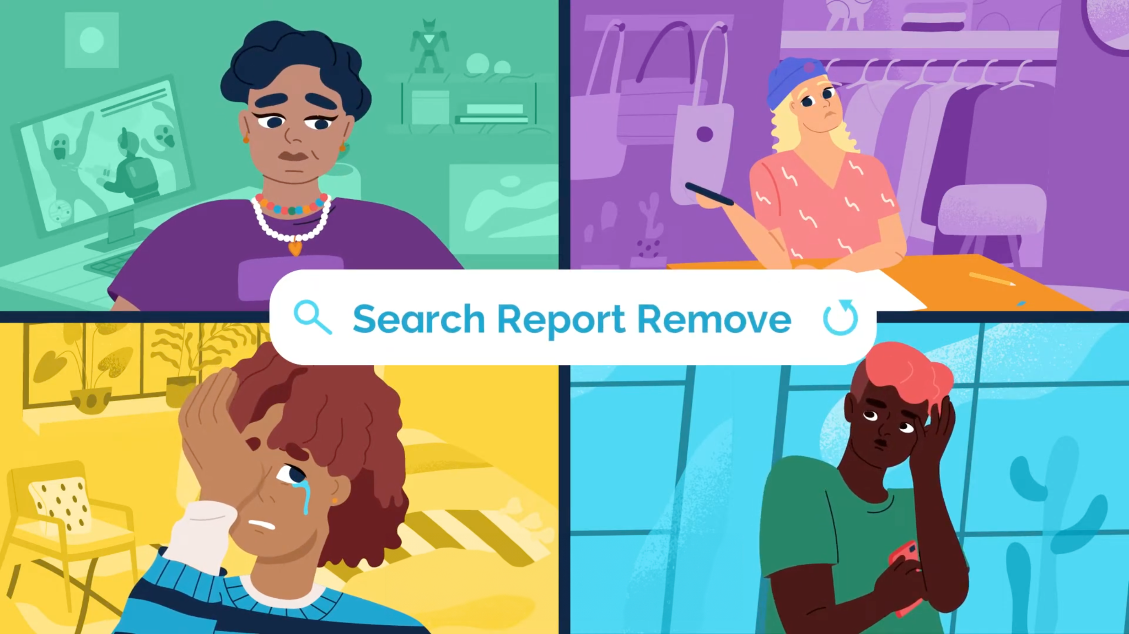
Notes:
Link: https://www.youtube.com/watch?time_continue=56&v=SwSpo3N6CeE&embeds_referring_euri=https%3A%2F%2Fwww.childline.org.uk%2F
Choice of slide between 13 or 14

Slide 14
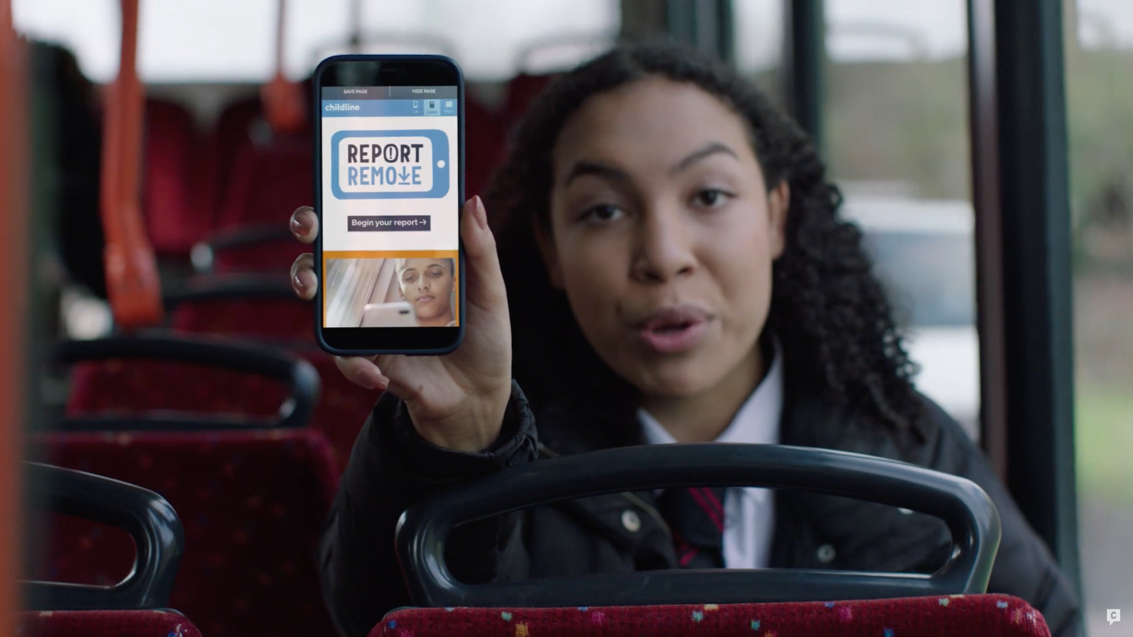
Notes:
https://www.iwf.org.uk/our-technology/report-remove/
Choice of slide between 13 or 14

Slide 15
When you share a nude photo or video of someone who’s under 18 – even if it’s of yourself – it’s illegal. That’s because it’s an indecent image of a child.
Sharing images of someone without their consent is also against the law. It can have long-lasting consequences.

Slide 16
At this school, we are on your side.
We won’t blame you if a nude photo of you is being shared.
We’ll try and help you get it taken down – and support you with whatever is happening.

Slide 17
Notes:
Rez is in year 10. For the past couple of days, he’s been messaging a girl he likes in the year below. They seem to be getting on well, and he wants to take their relationship to the next level.
Some of his mates have been sharing nude pics of themselves with girls they’re going out with, so he decides to do the same. He takes a few ‘dick pics’ and sends them to the girl he’s chatting to. But he doesn’t ask her first.
The girl just replies saying ‘WTF’ and blocks him. Rez realises he’s done something wrong. But the next day, things get worse.
His mates all start messaging him – saying they’ve seen his ‘dick pic’ in one of the group chats he’s not in. Suddenly his pics are going round the whole school, and everyone seems to be talking about it.

Slide 18
Rez is in year 10. For the past couple of days, he’s been messaging a girl he likes in the year below. They seem to be getting on well, and he wants to take their relationship to the next level.
Some of his mates have been sharing nude pics of themselves with girls they’re going out with, so he decides to do the same. He takes a few ‘dick pics’ and sends them to the girl he’s chatting to. But he doesn’t ask her first.
The girl just replies saying ‘WTF’ and blocks him. Rez realises he’s done something wrong. But the next day, things get worse.
His mates all start messaging him – saying they’ve seen his ‘dick pic’ in one of the group chats he’s not in. Suddenly his pics are going round the whole school, and everyone seems to be talking about it.

Slide 19
In this story, who’s in the wrong? Should someone apologise?

Slide 20
In this story, who’s in the wrong? Should someone apologise?
How do you think the girl felt when she received Rez’s picture out of the blue?

Slide 21
In this story, who’s in the wrong? Should someone apologise?
How do you think the girl felt when she received Rez’s picture out of the blue?
What should Rez do next?

Slide 22
Here’s how to respond to common reactions to Rez’s story.
“Rez is in the wrong because he sent his photos without permission.”
Explain that, yes, he made a mistake. He didn’t have consent to share his nudes, and that is wrong. But sharing the image on is wrong, too.
“What happened next?”
Frame this as a class discussion – what do they think the consequences will be?
“Everyone sends nudes, what’s the problem?”
Remind students of the law, and the Government guidelines – and potentially open a discussion about whether it’s right to share nude photos at any age.
For teachers’ use only
Notes:
For teachers use only. You can use this slide to help prepare for the session but remember to hide or delete it before running the session with students.

Slide 23
Before you share a nude photo of yourself, ask:
How would I feel if everyone saw this?
Because when you share a nude online, it could end up anywhere.

Slide 24
Notes:
When Roxy was in year 8, she got a message from a boy in the sixth form. She felt flattered to get attention from him, so when he asked for her socials, she said yes.
He used to message her every day, asking for pictures from her. Eventually, he asked her for nude photos – and she thought he’d lose interest if she didn’t send them.
No matter what she sent, he kept asking for more explicit pictures – so eventually she stopped talking to him. But a few weeks later, she found out that he’d sent her photos to other boys in her school.
Her photos were being shared on social media without her consent, and going round the whole year. People were calling her really hurtful names.
When the school found out, they made her write an essay as a punishment – while nothing happened to the boys who shared her photos.
Roxy is a real person. Now, she’s in her twenties – and educates young people about the dangers of sharing nudes, and how it’s not their fault if their images are shared without their consent.

Slide 25
When Roxy was in year 8, she got a message from a boy in the sixth form. She felt flattered to get attention from him, so when he asked for her socials, she said yes.
He used to message her every day, asking for pictures from her. Eventually, he asked her for nude photos – and she thought he’d lose interest if she didn’t send them.
No matter what she sent, he kept asking for more explicit pictures – so eventually she stopped talking to him. But a few weeks later, she found out that he’d sent her photos to other boys in her school.
Her photos were being shared on social media without her consent, and going round the whole year. People were calling her really hurtful names.
When the school found out, they made her write an essay as a punishment – while nothing happened to the boys who shared her photos.
Roxy is a real person. Now, she’s in her twenties – and educates young people about the dangers of sharing nudes, and how it’s not their fault if their images are shared without their consent.

Slide 26
Do you think the way Roxy was treated was unfair?

Slide 27
Do you think the way Roxy was treated was unfair?
If you were in Roxy’s position, what would you do?

Slide 28
Here’s how to respond to common reactions to Roxy’s story.
“Roxy shouldn’t have shared her photos”
Be ready to challenge ‘slut-shaming’ or victim-blaming attitudes. Remind students that Roxy was a young teenager at the time and she couldn’t have known that once images are shared, they can end up anywhere. Reiterate that the pressure put on her was wrong.
“Roxy’s school was in the wrong, so I wouldn’t tell teachers anything”
Explain that Roxy’s story is from a few years in the past, and that schools have moved on since. Reiterate that everyone at this school is here to help.
“Everyone sends nudes, what’s the problem?”
Remind students of the law, and the Government guidelines – and potentially open a discussion about whether it’s right to share nude photos at any age.
For teachers’ use only
Notes:
For teachers use only. You can use this slide to help prepare for the session but remember to hide or delete it before running the session with students.

Slide 29
“I just felt like I’d done this terrible thing that I’d been told not to do, and that my parents would be angry, there was just no-one I could go to.”
Roxy

Slide 30
When someone’s asking to see your nudes, ask yourself:
Do I really know them? Do I trust them? Do I want to share a nude image or video? Why are they pressuring me?
And if you have been pressured to share your images, remember: you’ve done nothing wrong.
To get help, tell a trusted adult, speak to Childline, or get your images taken down by using Report Remove.

Slide 31
Notes:
Jack’s in year nine. He’s been questioning his sexuality for a while and he’s curious about what it would be like to have a boyfriend.
One night, a friend’s older brother (who’s in year 11) messages him. They start chatting. The messages become more flirty until the older boy asks Jack for a nude pic. Jack sends it. The other boy doesn’t send one back, and ghosts him.
The next day, Jack’s at football practice. Some of his teammates are laughing, saying they’ve seen him naked. He feels embarrassed and doesn’t know who else has seen the pics.

Slide 32
Jack’s in year nine. He’s been questioning his sexuality for a while and he’s curious about what it would be like to have a boyfriend.
One night, a friend’s older brother (who’s in year 11) messages him. They start chatting. The messages become more flirty until the older boy asks Jack for a nude pic. Jack sends it. The other boy doesn’t send one back, and ghosts him.
The next day, Jack’s at football practice. Some of his teammates are laughing, saying they’ve seen him naked. He feels embarrassed and doesn’t know who else has seen the pics.

Slide 33
Who’s in the wrong in this story?

Slide 34
Who’s in the wrong in this story?
How would you feel if you were Jack?

Slide 35
Who’s in the wrong in this story?
How would you feel if you were Jack?
What should Jack do next?

Slide 36
Here’s how to respond to common reactions to Jack’s story.
“How is Jack meant to explore his sexuality if he can’t send pics”
Recognise that, at Jack’s age, it’s normal to be curious. But it’s better to discuss with a trusted adult than with people on the internet. Remind them that, as the legal age for sexual acts is 16, Jack is still a minor.
Any homophobic comments.
Challenge these, and refer to the school’s anti-bullying policy.
“Everyone sends nudes, what’s the problem?”
Remind students of the law, and the Government guidelines – and potentially open a discussion about whether it’s right to share nude photos at any age.
For teachers’ use only
Notes:
For teachers use only. You can use this slide to help prepare for the session but remember to hide or delete it before running the session with students.

Slide 37
It’s OK to explore and discuss your sexuality, but it’s important to keep safe.
When someone’s asking to see your nudes, ask yourself:
Do I really know them? Do I trust them? Do I want to share a nude image or video? Why are they pressuring me?
Get help by telling a trusted adult, speak to Childline, or get your images taken down by using Report Remove.

Slide 38
Notes:
Nadia is in her room, scrolling on her phone. Suddenly, she gets a message from her friend Lottie. It’s a photo.
She opens the message. It’s a topless pic of another girl from their year. Underneath it Lottie’s written a nasty message, ‘lol she’s so ugly’.
Nadia is shocked. She sends a message back, asking Lottie where she got the photo from.
Lottie replies saying one of the boys at school sent it to her. Lottie finds it funny.
Nadia is worried the other girl has no idea her photo is being shared round. She doesn’t know what to do.

Slide 39
Nadia is in her room, scrolling on her phone. Suddenly, she gets a message from her friend Lottie. It’s a photo.
She opens the message. It’s a topless pic of another girl from their year. Underneath it Lottie’s written a nasty message, ‘lol she’s so ugly’.
Nadia is shocked. She sends a message back, asking Lottie where she got the photo from.
Lottie replies saying one of the boys at school sent it to her. Lottie finds it funny.
Nadia is worried the other girl has no idea her photo is being shared round. She doesn’t know what to do.

Slide 40
What might be the consequences of Lottie’s decision to share that photo?

Slide 41
What might be the consequences of Lottie’s decision to share that photo?
If you were the person whose photo was being shared behind their back, how would you feel?

Slide 42
What might be the consequences of Lottie’s decision to share that photo?
If you were the person whose photo was being shared behind their back, how would you feel?
What should Nadia do next?

Slide 43
Here’s how to respond to common reactions to Nadia’s story.
“Won’t Nadia get in trouble for having the photo now?”
Acknowledge that it’s illegal for Nadia to have the image, but that by choosing to act and help the girl she won’t be in trouble. But if she chooses to send it on, she could be.
“The boys are just messing around”
Reiterate that it’s illegal to share the images of someone who is under 18, or without someone’s consent. Ask them: how would you feel if they were sharing your image?
“Everyone sends nudes, what’s the problem?”
Remind students of the law, and the Government guidelines – and potentially open a discussion about whether it’s right to share nude photos at any age.
For teachers’ use only
Notes:
For teachers use only. You can use this slide to help prepare for the session but remember to hide or delete it before running the session with students.

Slide 44
If you see somebody sharing someone else’s nudes without their consent, you need to say something – if you feel it’s safe to do so.
You’re not being a grass – you’re keeping them safe.
It’s not easy, but you should tell a trusted adult.

Slide 45
Notes:
Rhys is in his room, scrolling on his phone. He gets a follow request and a message from a girl. He thinks she looks really good in her profile pic.
They start sending messages back and forth, and Rhys thinks they’re getting on. The girl says she thinks Rhys is cute. They start flirting, then the girl asks to start a video call.
Rhys joins the call and it looks like the girl’s naked. It looks real. She’s still messaging Rhys, pressuring him to copy the sexual things she’s doing on screen. He does it.
Then, suddenly, the ‘girl’ ends the call. She starts to sound aggressive, saying she’s recorded what Rhys did and threatens to send it to all his followers. She plays the video back to prove she’s serious.
Rhys is stunned. He begs her not to share the video with anyone. She says he needs to pay her £500, otherwise she’ll share it with everyone he knows.
Rhys panics and blocks her. But he’s terrified that his video will be shared.

Slide 46
Rhys is in his room, scrolling on his phone. He gets a follow request and a message from a girl. He thinks she looks really good in her profile pic.
They start sending messages back and forth, and Rhys thinks they’re getting on. The girl says she thinks Rhys is cute. They start flirting, then the girl asks to start a video call.
Rhys joins the call and it looks like the girl’s naked. It looks real. She’s still messaging Rhys, pressuring him to copy the sexual things she’s doing on screen. He does it.
Then, suddenly, the ‘girl’ ends the call. She starts to sound aggressive, saying she’s recorded what Rhys did and threatens to send it to all his followers. She plays the video back to prove she’s serious.
Rhys is stunned. He begs her not to share the video with anyone. She says he needs to pay her £500, otherwise she’ll share it with everyone he knows.
Rhys panics and blocks her. But he’s terrified that his video will be shared.

Slide 47
“I’m being blackmailed by a girl who recorded an explicit video of me. She says she’ll post it online if I don't give her hundreds of pounds. I don’t have that kind of money.”
Rhys

Slide 48
What were the signs that the ‘girl’ wasn’t who she said she was?

Slide 49
What were the signs that the ‘girl’ wasn’t who she said she was?
What should Rhys do now?

Slide 50
Here’s how to respond to common reactions to Rhys’s story.
“It’s Rhys’ own fault for adding someone he doesn’t know”
Ask the class whether they’ve ever added a stranger online – the majority will have. Acknowledge the pressures to be popular online. Stress that Rhys was taken advantage of – and it’s not his fault.
“The girl was just joking”
Explain that this type of extortion is a real, widespread issue, and it can have devastating consequences. Encourage the class to empathise with how Rhys must have felt when he was threatened.
“Just pay the girl off”
Explain that the person Rhys spoke to is a criminal, and should never be paid. Explain that for many teenagers (and adults!), that sum of money is inaccessible. Remind the class that police guidance is to never pay blackmailers.
For teachers’ use only
Notes:
For teachers use only. You can use this slide to help prepare for the session but remember to hide or delete it before running the session with students.

Slide 51
They’re moving too fast – they want to start a relationship quickly, or send you images first
It seems too good to be true – they’re offering you an exciting job, like modelling, or they’re offering a lot of money for your images
They pressure you to share sexual images – or get nasty, saying you’re boring if you don’t do it
They tell you they’ve hacked you, or accessed your contacts

Slide 52
If you’re not comfortable, end the chat immediately. Don’t respond, just block and report them.
And if you are being threatened in this way, remember it’s not your fault.
Stop all contact, tell a trusted adult – or report it to the police, either by calling 101 or online.
Notes:
Find more information and support at https://www.ceopeducation.co.uk/11_18/lets-talk-about/sexual-abuse/online-blackmail
https://www.met.police.uk/advice/advice-and-information/sexual-offences/sextortion/

Slide 53
At [school name], we’re here to help you. Whether you’ve:
shared images of yourself
shared images of someone else
or seen nudes being shared
We can help you sort it – and keep everyone safe.
Talk to [DSL name] or [teacher name].
Add school logo here.
Remove this note before presentation.

Slide 54
Remember, if you need to get an image of you taken off the internet, use Report Remove.
It’s safe, easy to do and totally free.

Slide 55
Call for free on 0800 1111 or search: Childline
Get advice about
harmful sexual behaviour at Shore – visit shorespace.org.uk
Get free, confidential 24/7 text support if you’re struggling – just text SHOUT to 85258
Contact the police
on 101, or call 999
in an emergency

